Slide 1
Good Practices: Keeping BASIC academic lab notes
Gemma Lionheart

Slide 2
Your laboratory notebook is…
A daily record of every experiment you do, think of doing, or plan to do AND your thoughts about each experiment and the results thereof.
The legal property of your institution.
The basis of every paper/thesis/dissertation you write.
A legal document. In industry it is the record used by patent offices and, in the case of disputes, courts of law (in the event you file patents on your findings). Laboratory notebooks can be subpoenaed.
A record that would enable successive scientists, working on the related projects, to pick up where you left off or reproduce your results.

Slide 3
Thankfully, we are not in industry
Ergo we are not subject to cGXP federal guidelines.
Discrepancies in laboratory notes in industry can constitute gross misconduct (not for us though, phew!)
Our focus is:
Personal integrity
Understanding that our research is part of a broader scope of work in the scientific community
Respect for our PI, collaborators and institution
Accountability and transparency
The ability to self-check and troubleshoot our work
Notes:
Let’s not have the pharmaceutical industry be more accountable than we are

Slide 4
Common experimental notes
Planning
Descriptive heading, date, log info in table of contents.
Objective: Why are you doing this experiment?
Procedure:
Execution
How did your experiment deviate from your plan?
Results
Conclusions & ideas
Your analysis and discussion of the meaning of your results
Photocopies of protocols
Diagrams or figures where they will bring clarity e.g. plate layout
A clear, thorough description of your observations and the outcome of your experiments.
Any figures, data, graphs associated with your experiments.
The implications of these conclusions on future work. What are your next steps? What are you thinking at this stage?
It is very unlikely that your experiment went perfectly. This is to be expected, and details thereof noted.
Notes:
For results and conclusions: what you see and think may be very different from what someone else sees and thinks. Be clear. Think of Darwin. We can read his notes and know what he was thinking and how he interpreted his results.

Slide 5
The goal
Somebody with a similar level of scientific training should be able to read your notes and:
accurately reproduce your experiments.
understand why you performed the experiment you did, and what you gleaned from your results.
check for errors.
This requires including enough detail on your actions that somebody could compare it to your protocols and derive any logical errors that may have occurred e.g. dilution information, lot numbers, any math you used to come to a decision.

Slide 6
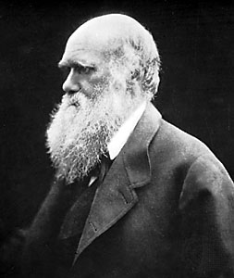
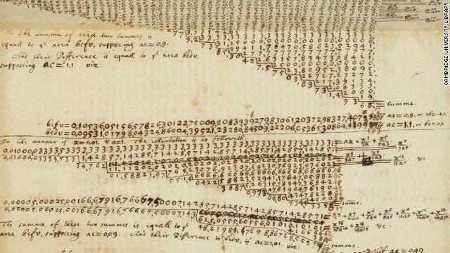
After all… The Scientific Method
“A method of procedure that has characterized natural science since the 17th century, consisting of systematic observation, measurement, and the formulation, testing, and modification of hypotheses.”

Slide 7
Tips and tricks
To save time writing out lengthy protocols, print them out and tape in only relevant sections that accurately describe your actions.
Double tape papers into lab books, or staple securely.
Develop a personal system of note organization which is clear.
Make use of diagrams and figures.
Don’t put off writing notes until a later date – you will forget details.
Write clearly.
Schedule time in your day for writing notes.
Use a notebook with pre-printed, numbered pages, and never tear pages out.
Create a cloud folder for any documents relating to each lab book, and use a system that allows you to find files in the folder easily.

Slide 8
Tips and tricks cont.
U.S. date convention is atypical in a global environment. Use two digits day, three letter month, four digit year e.g. 03MAR2014
Cross out with only one line. Initial and date mistake e.g. G.L.08MAY2015
Feel free to use abbreviations in your note-taking to save time. Include an abbreviation glossary in your notebook for clarity.

Slide 9
Exercise your science muscles
Writing copious, exhaustive analyses of your experiments is not simply for other people’s benefit.
Learning how to evaluate your work in a more rigorous way will improve your research for the rest of your life.
It allows you to look at your own work from various vantage points, and develops your analytical and observational abilities.
Practice makes perfect. This type of note taking becomes easier and faster over time.
Notes:
Gemma fact: Amazing lab notes make writing journal articles a lot, lot easier.

Slide 10
Questions?
Gemma Lionheart

